Slide 1

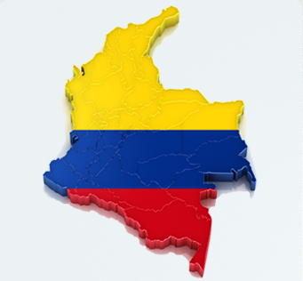
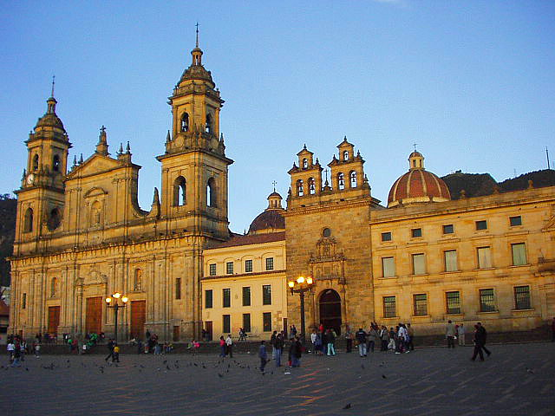
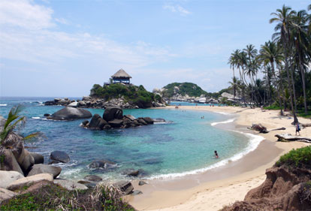
GSB
Colombia!
Hotels
Aug 23 – 31

Slide 2
GSB Colombia!
Cartagena – Hotel Portal San Diego
Trip Advisor Link: Click Me
Room Types & Price/Night :
1 Double - $59 (22 available)

Slide 3
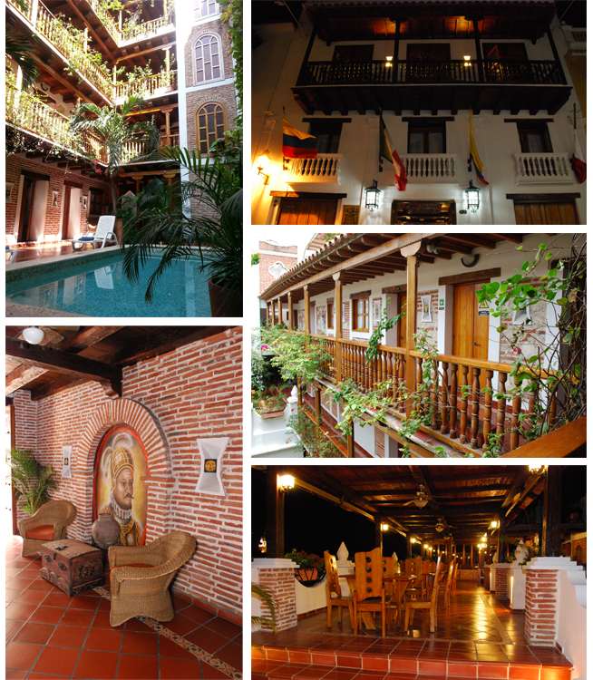
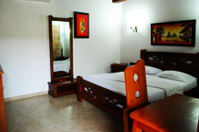
GSB Colombia!
Cartagena – Don Pedro Heredia
Trip Advisor Link: Click Me
Room Types & Price/Night :
1 Double - $64 (22 available)
2 Singles - $64 (18 available)

Slide 4
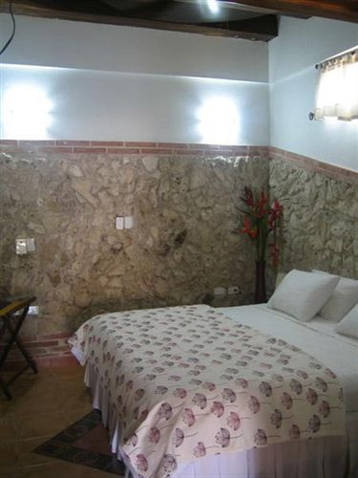
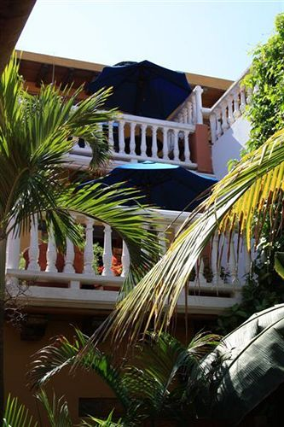
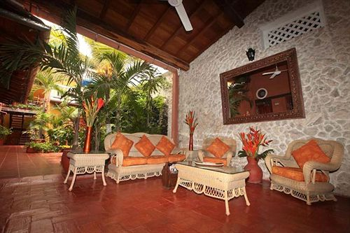
GSB Colombia!
Cartagena – Hotel 3 Banderas
Trip Advisor Link: Click Me
Room Types & Price/Night :
1 Double - $69 (34 available)
2 Singles - $69 (12 available)

Slide 5
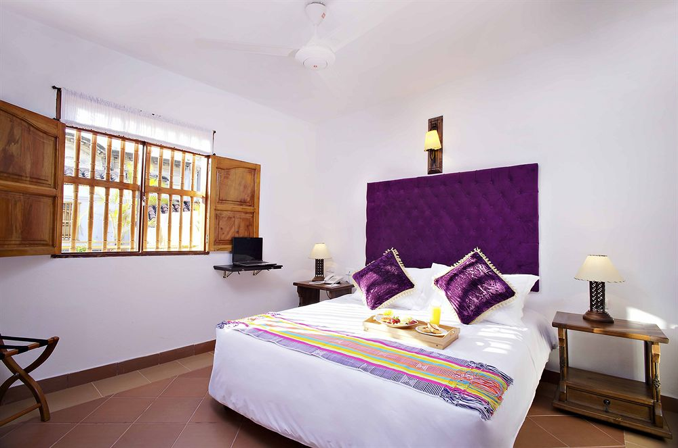
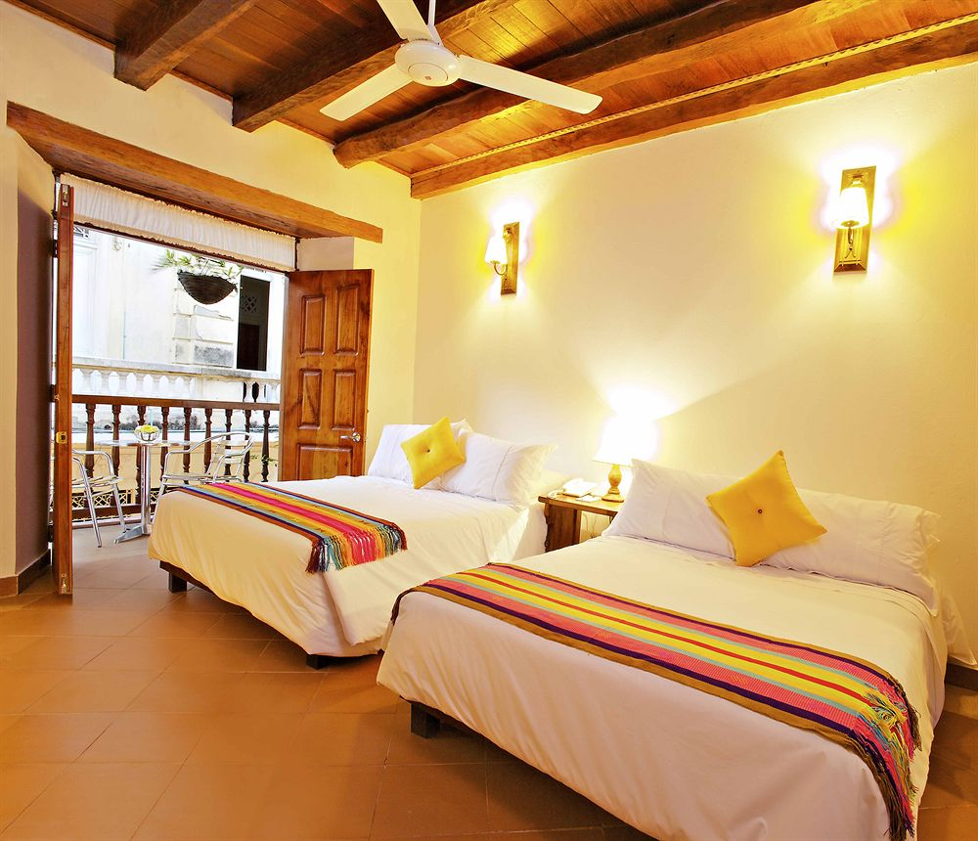
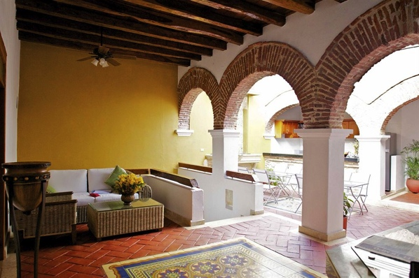
GSB Colombia!
Cartagena – Hotel Carretas
Trip Advisor Link: Click Me
Room Types & Price/Night :
1 Double - $98 (12 available)
2 Singles - $98 (8 available)

Slide 6
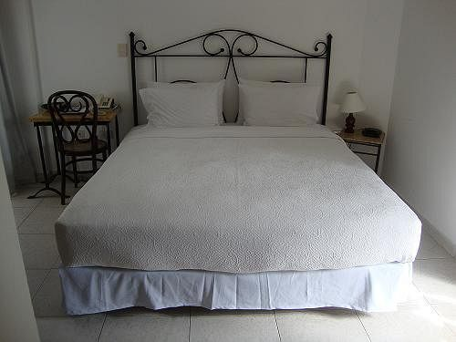
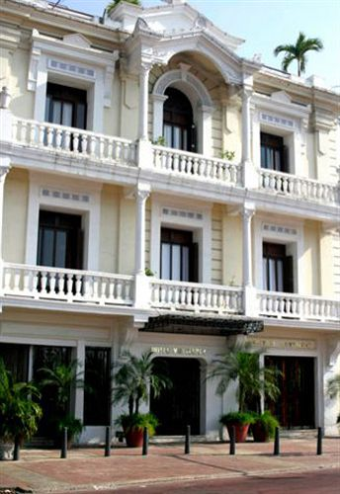
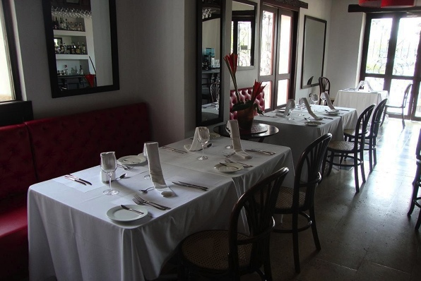
GSB Colombia!
Cartagena – Monterrey
Trip Advisor Link: Click Me
Room Types & Price/Night :
1 Double - $101 (36 available)
2 Singles - $101 (14 available)

Slide 7
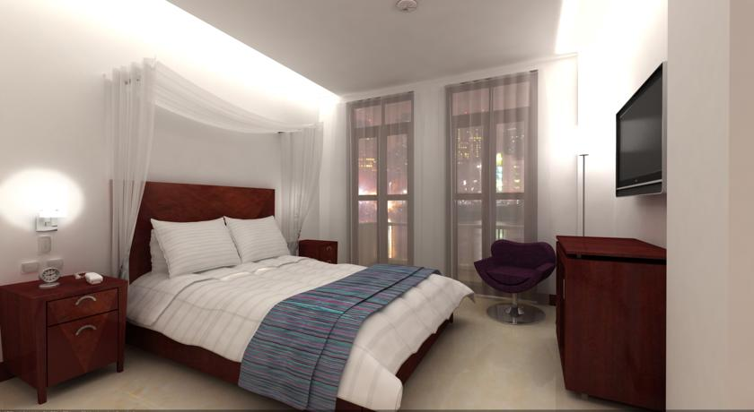
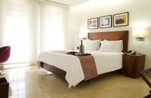
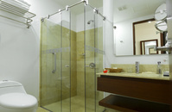
GSB Colombia!
Cartagena – Urban Royal
Trip Advisor Link: Click Me
Room Types & Price/Night :
1 Double - $115 (34 available)
2 Singles - $115 (8 available)

Slide 8
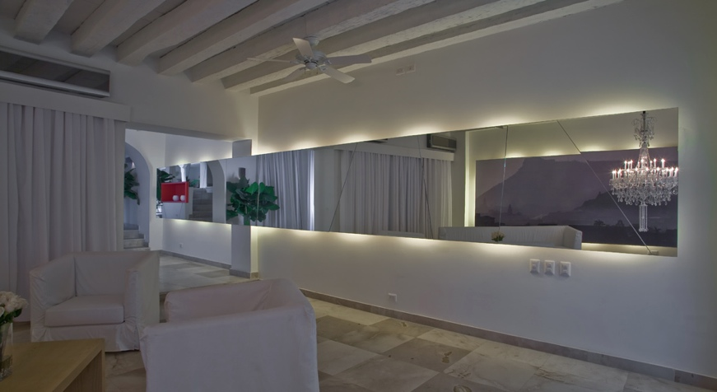
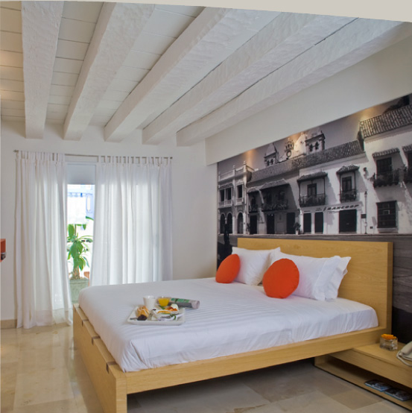
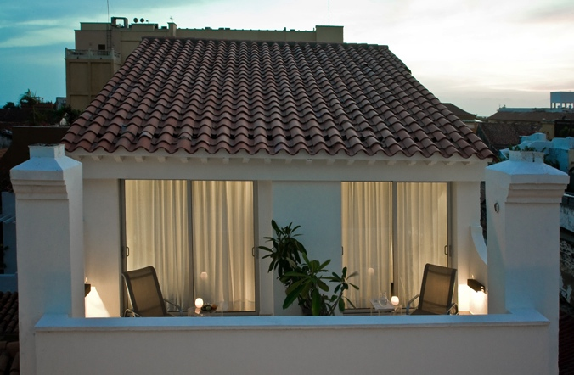
GSB Colombia!
Cartagena – Delirio
Trip Advisor Link: Click Me
Room Types & Price/Night :
1 Double - $146 (16 available)
2 Singles - $146 (6 available)

Slide 9
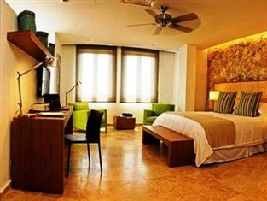
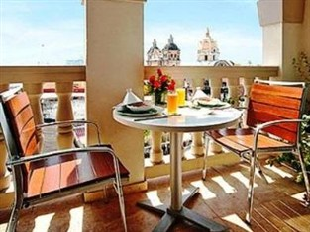
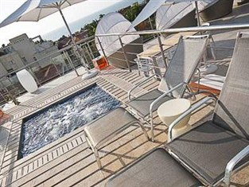
GSB Colombia!
Cartagena – Movich
Trip Advisor Link: Click Me
Room Types & Price/Night :
1 Double - $160 (30 available)

Slide 10
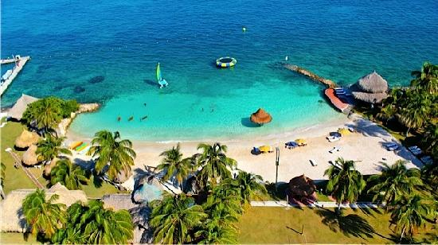
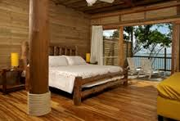
GSB Colombia!
Isla Mucura– Punta Faro
Trip Advisor Link: Click Me
Room Types & Price/Night :
Double - $190 (26 available)
Triple - $175 (9 available)
Quad - $150 (52 available)
Alt Quad - $140 (32 available)
Quint - $110 (115 available)
Alt Quint - $100 (10 available)
*Note Punta Faro is the only housing
option for Isla Mucura

Slide 11
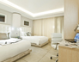
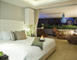
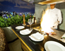
GSB Colombia!
Medellin– Hotel Charlee
Trip Advisor Link: Click Me
Room Types & Price/Night :
1 Double - $185 (20 available)
2 Singles - $150 (20 available)

Slide 12
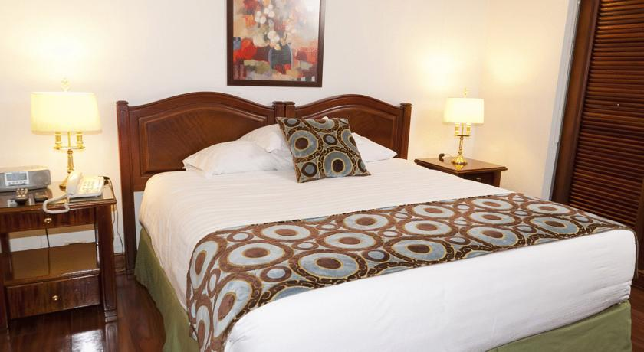
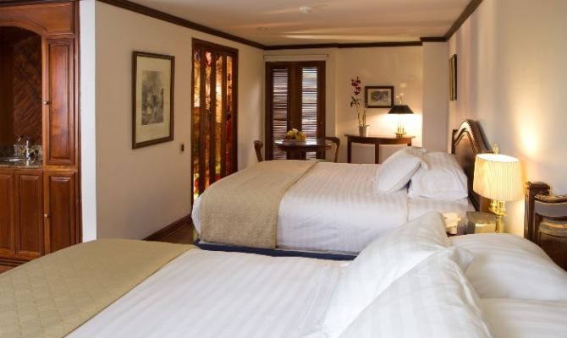
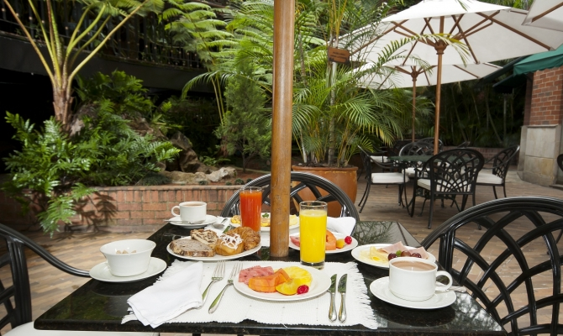
GSB Colombia!
Medellin– Hotel Park
Trip Advisor Link: Click Me
Room Types & Price/Night :
1 Double - $100 (50 available)
2 Singles - $100 (20 available)

Slide 13
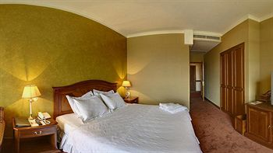
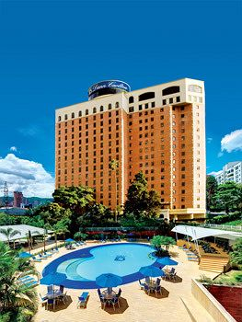
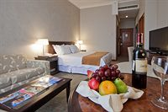
GSB Colombia!
Medellin– Hotel Dann Carlton
Trip Advisor Link: Click Me
Room Types & Price/Night :
1 Double - $95 (40 available)
2 Singles - $95 (30 available)

Slide 14
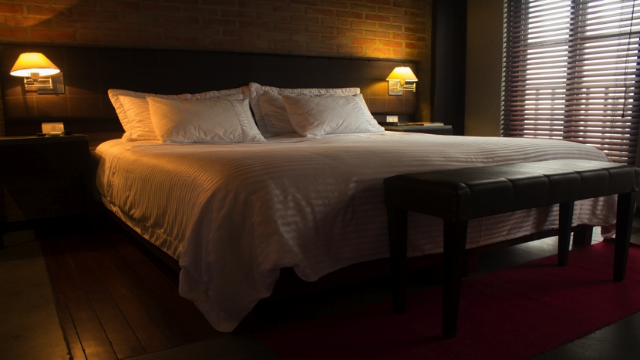
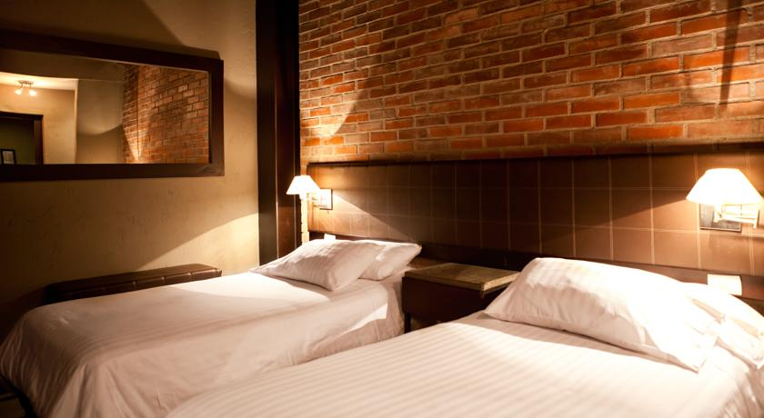
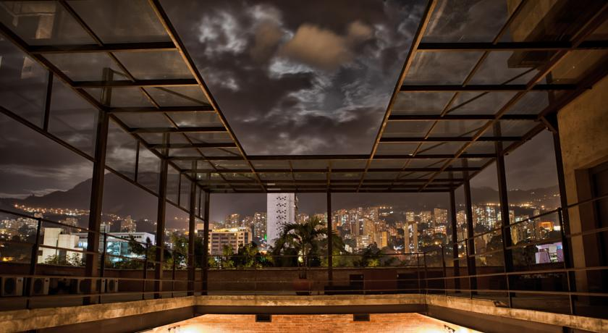
GSB Colombia!
Medellin– Hotel Art
Trip Advisor Link: Click Me
Room Types & Price/Night :
1 Double - $65 (20 available)
2 Singles - $65 (60 available)

Slide 15
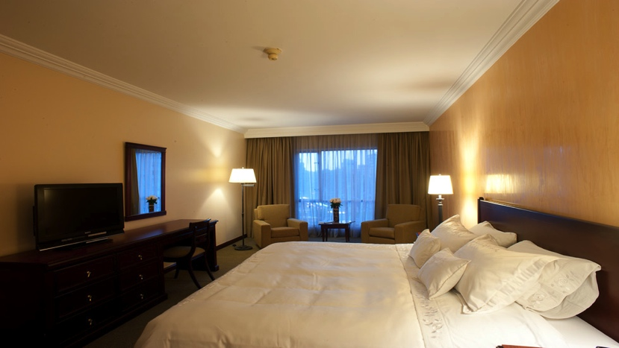
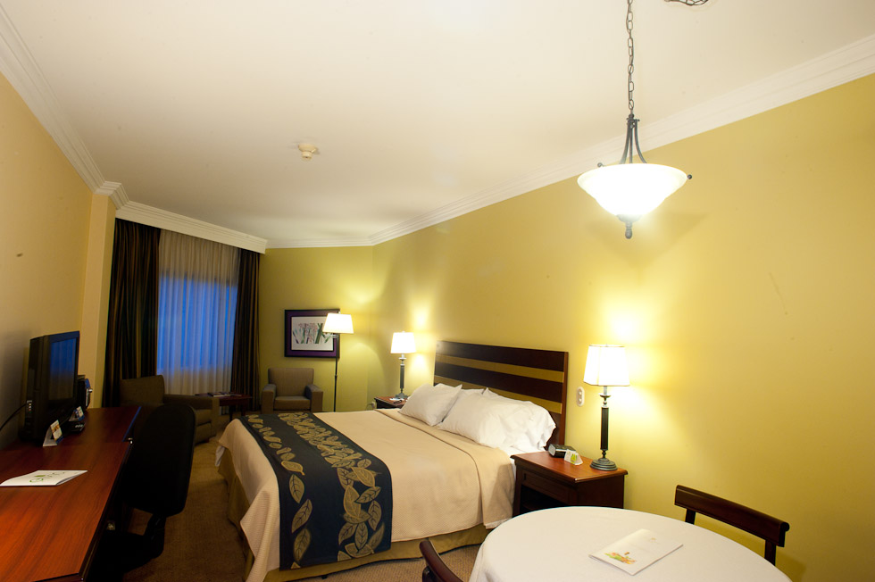
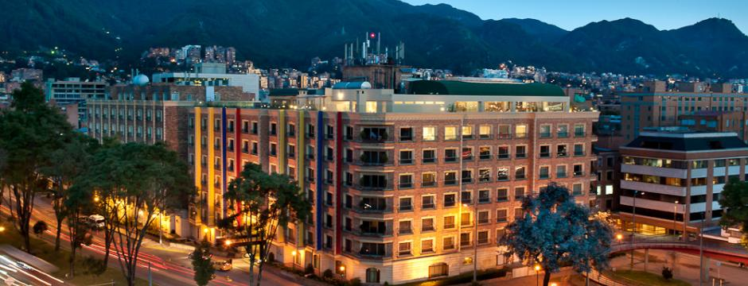
GSB Colombia!
Bogotá– Casa Dann Carlton
Trip Advisor Link: Click Me
Price : $75/night
*Note this is the only hotel choice for Bogotá

Slide 16
Questions?
Contact:
registration@gsbcolombiatrip.com
info@gsbcolombiatrip.com

